Slide 1
Analysis of Aggravated Assault (AGG)
Presented By:
Harshit Patel
Vaishnavi Kunchala

Slide 2
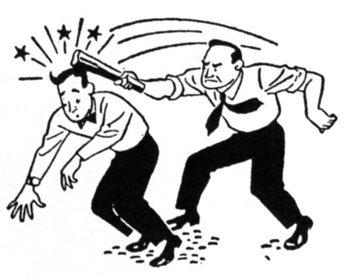
What is Aggravated Assault?
Defined as the unlawful attempt or completed attack upon another.

Slide 3
Descriptive Analysis of AGG
There have been 2,545 assaults occurring since 2011 in Los Angeles.
Assaults have been mainly happening in premises such as Bar/Cocktail, Street/Parkways, Junior High Schools, Restaurants, Alleys, and Theatres.
Visualization can be done for crimes happening in each reporting district by year.

Slide 4
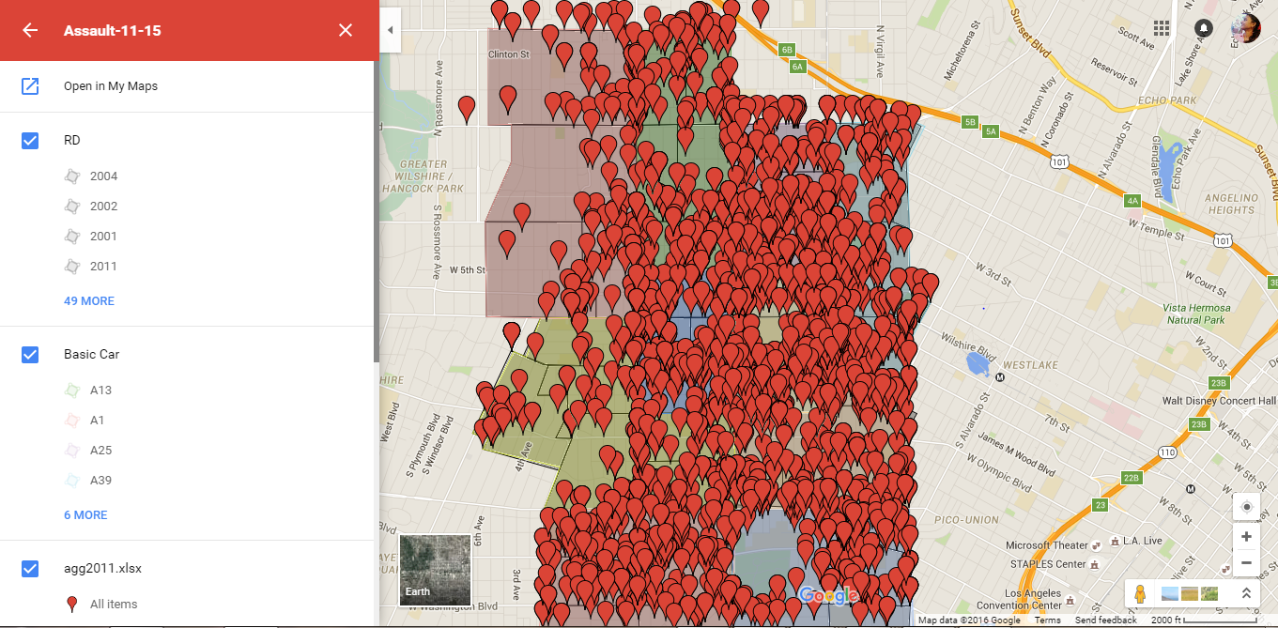
Google Maps representing crime rate in each reporting district by year.

Slide 5
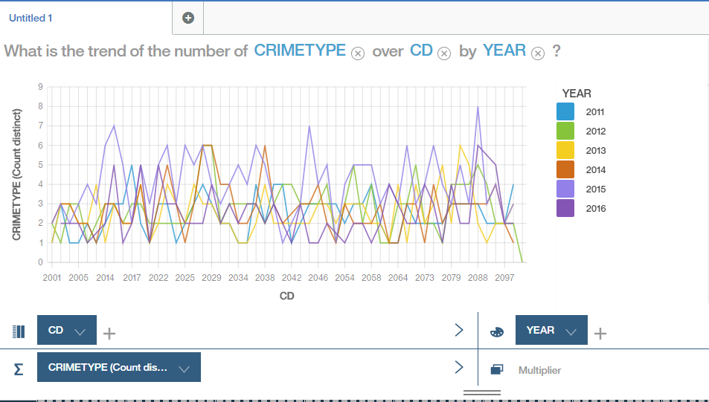
Number of crimes for each reporting district by year

Slide 6
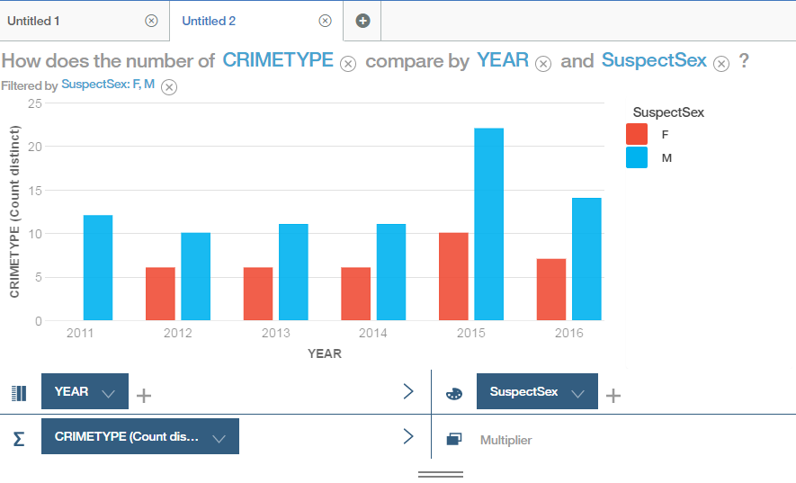
Number of crimes for males vs females by year

Slide 7
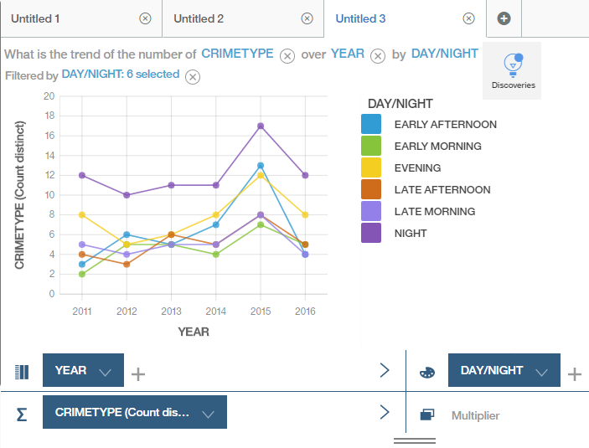
Number of crimes during the Day vs Night

Slide 8
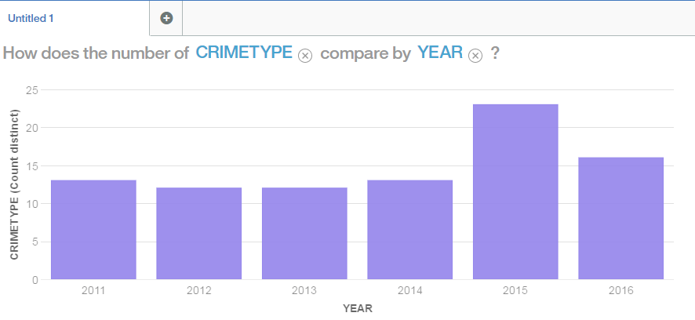
Predictive Analysis of AGG
Crime rate was higher in the year of 2015. By the end of 2016, Crime rate may increase even more than the previous year.

Slide 9
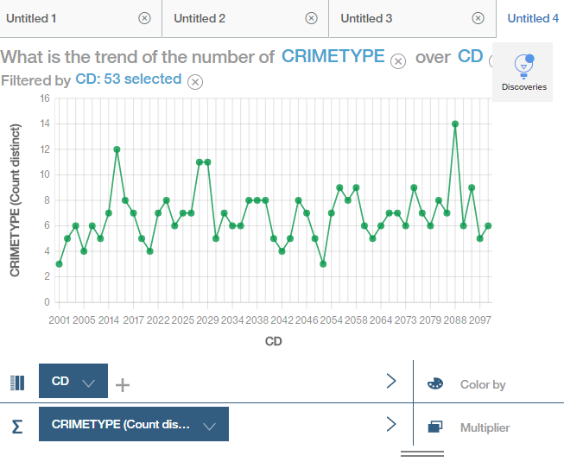
A high number of crimes seem to occur in the reporting districts of 2014, 2025, 2029, 2088.

Slide 10
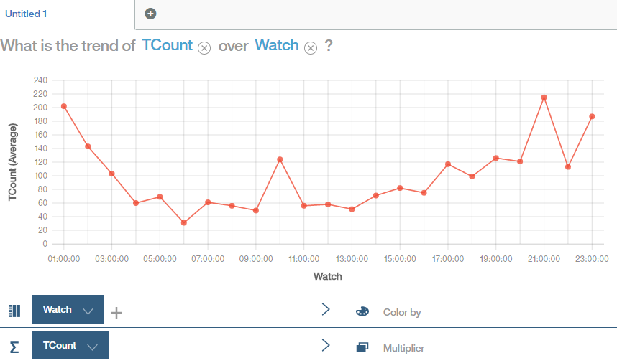
Aggravated assaults usually happen at night around 8p.m to 2a.m.

Slide 11
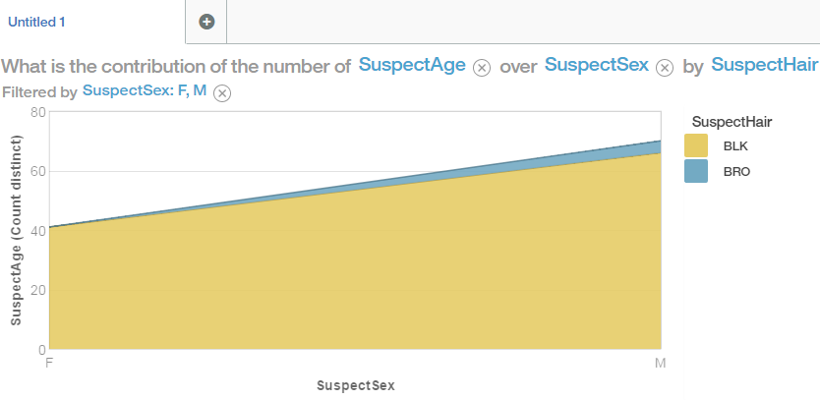
Perpetrator Profile and Threat Level Assessment
Male suspects around the age of 30-40 are more to commit crime.

Slide 12
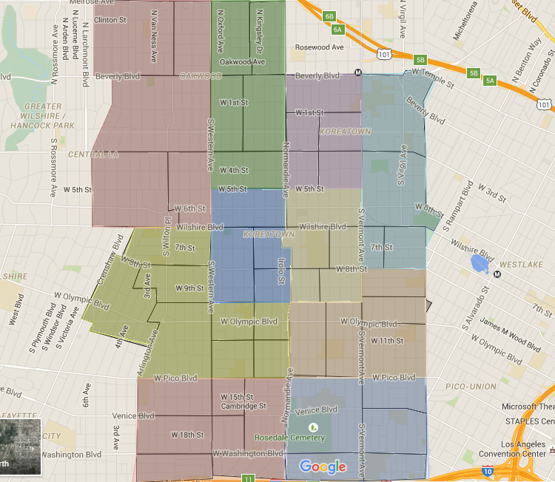
Prescriptive analysis of AGG
Within RD 2029, Patrol emphasis should focus in S VERMONT AVE.
Within RD 2017, Patrol emphasis should focus more in S BERENDO AVE.
Within RD 2088, Patrol emphasis should focus more in WASHINGTON BL & VERMONT AVE.

Slide 13
Conclusion and Final Analysis of AGG
As most of the crimes are occurring at night around 8p.m to 2a.m, Patrols should be more careful at this time.
More number of patrols can be arranged around more prone reporting districts such as 2029, 2017 and 2088.
When the crime is reported to the Patrol, they should take immediate action.

Slide 14
T
h
A
n
K
U

